Slide 1
Managing Information Technology Resources ITWS 4310
Cyber Security
November 19, 2018

Slide 2
Managing IT Resources Class Outline: Mon, Nov 19, 2018
MITR Term Project
Schedule Meetings with Client and Invite Faculty to Meetings
Finish the Entire Project
Draft of Entire Term Project Final Report TONIGHT by 9 PM
Final Presentations on Dec 6 and Dec 10
All Teams Submit Final Reports on Dec 10
All Students Grade and Rank all Presentations by Dec 11
All Students Complete Peer Evaluations of Their Team by Dec 11
Quiz
Current Events
Chapter 17: Cyber Security

Slide 3
Randomly Assigned Final Presentation Schedule
Thursday Dec 6
Team 5
Team 2
Team 4
Monday Dec 10
Team 3
Team 1
Team 6
Invite your Clients to attend your class presentation and any or all of the other presentations on the two days.
In Addition, offer to present in a longer format (~ 1 hour) at the Client’s Location or on a Video Link to the Client’s Location.
If your Client cannot attend the day scheduled, but could on the other day, let us know and we will try to accommodate.
Presentations will be 15 minutes long with 5 minutes for Q&A. Time will be monitored and you will be given visual warnings at 3, 2, 1 minutes respectively.

Slide 4
Managing IT Resources ITWS 4310-01 Term Project Final Presentations
10-15 minutes for presentation and demo
5 minutes for Q&A
All team members present and participating
Business Attire
Invite Clients to Presentation
All students grade and rank other presentations

Slide 5
Suggestions for Oral Presentations
Be prepared: know the material well
Be prepared: practice with other team members and before a live audience
Introduce self and team
One person in front of audience at one time – others “off stage” to side
Tell audience what you are going to cover verbally or in an agenda
Display energy and engagement
Display good posture
Speak clearly and loudly enough so that you can be heard throughout the room
Move your head and body to speak to all parts of the room
Make direct eye contact with audience members in various parts of the room
Use gestures to emphasize points and to point to some particularly important aspects of the visuals. Do not use so many gestures that it is distracting.
Keep your hands out of pockets or other parts of clothing
Use transitions to new presenter – introduce next presenter – next presenter says “Thanks xyz” and start with strong first sentence
Summarize at end of section and end of presentation – strong conclusion
Plan the time to be taken by each presenter. Remember transition times. Practice for timing. Keep within time allotted.
Prepare the slides so that they are visually attractive, communicate key points, have good flow, are “branded” for the particular talk, are of sufficiently large font that they can be read from the back of the room
Practice, practice, practice!

Slide 6
Project | Client, Team, Problem, Solution Concept | CBA, Risk Anal., Project Plan, Schedule | Requirements, Design, Development | Results, Conclusions, Lessons Learned, Challenges | Demon-stration of Solution | Presentation, Slides, Speaking | Total | Rank Order (1=Best) No ties. Do not Rank own Team
Points Possible | 1.0 | 1.0 | 2.0 | 2.0 | 2.0 | 2.0 | 10.0 | (1-5)
Team 5: OTELCO |  |  |  |  |  |  | 0.0
Team 2: AM/PM Design & DemoWorks |  |  |  |  |  |  | 0.0
Team 4: RPI Air Force ROTC |  |  |  |  |  |  | 0.0
Team 3: Cure Dystopia Now |  |  |  |  |  |  | 0.0
Team 1: Troy Cloth & Paper Co. |  |  |  |  |  |  | 0.0
Team 6: Carme.AI |  |  |  |  |  |  | 0.0

Slide 7
Evaluate the Performance of each Team Member on the Term Project (Score from 1-10 with 1 being poor and 10 being excellent)
Team Members | Self | Other Team Member 1 Enter Name Below | Other Team Member 2 Enter Name Below | Other Team Member 3 Enter Name Below
Evaluation Criteria/ Names
Contribute to the ideas for the team project
Attend and actively participate in team meetings
Contribute by being a good team leader
Contribute by being a good listener and team follower
Provide deliverables to team on time as committed
Contribute to the planning and organization of the project
Contribute to the technical aspects of the project
Contribute to the writing and presentation of the project
Contribute fair share of the overall workload to the project
Overall contribution to the team project
Total

Slide 8
Managing IT Resources: ITWS 4310 Term Project Report Outline
Section 1: Executive Summary
Section 2: Introduction
Section 3: Client Organization and Description
Section 4: Project Team
Section 5: Problem Statement
Section 6: IS/IT Solution
Section 7: Methodology
Section 8: IS/IT Requirements
Section 9: IS/IT Design
Section 10: Cost-Benefit Analysis with (Risk Mgmt)
Section 11: Project Plan/Schedule/Resources
Section 12: Post-Turnover Plan
Section 13: Results and Client Feedback
Section 14: Conclusions
All Sections of Final Report in Draft due by Nov 19 (Mon before Thanksgiving) at 9 PM

Slide 9
Managing IT Resources: ITWS 4310 Term Project Report Outline
Section 1: Executive Summary
Should be able to “stand on its own”
Provides an “executive” overview of the entire project
What are the important points that an executive would need to know?
The best summaries effectively balance details with a concise writing style

Slide 10
Managing IT Resources: ITWS 4310 Term Project Report Outline
Section 2: Introduction
Keep it short – 2-3 sentences
Only 2 objectives: provide a little context for the project and pique interest to read on
Section 3: Client Organization and Description
Give some idea of the size of the organization: number of employees, number of locations, etc.
Include Client Contact name and contact information
Section 6: IS/IT Solution
If solution has changed throughout semester, make reference to the original solution concept and then describe current/latest solution concept
Section 7: Methodology
Brief description of how each major aspect of project was done e.g. a cost benefit analysis focused on NPV and IRR was used to assess financial viability of the project. Don’t’ be repetitive with subject section
Cover project/client selection, requirements, development methodology, financial viability, project management, implementation methodology, and client feedback method

Slide 11
Managing IT Resources: ITWS 4310 Term Project Report Outline
Section 8: IS/IT Requirements
Categorize both Functional and Non-Functional Requirements
Section 9: IS/IT Design and Development
Use-Case Summary (part of narrative) and Use-Case Diagram
Work Flow Diagram (logic that connect back-end with front-end)
Back-end Design including Data Work Flow and Database Design
Front-end Design including Mock-ups, Wireframes, Screen Shots
Working System including link to working system or prototype
Access to Code in Code Repository
Test Plan(s) and Test Results
Narrative of All Design and Development
Section 10: Cost Benefit Analysis with Risk Management
Combine the Excel Sheets for CBA and Risk Management into one Excel Workbook
Combine the CBA and Risk Management into one Narrative

Slide 12
Managing IT Resources: ITWS 4310 Term Project Report Outline
Section 11: Project Management/Resource/Schedule
Specify reference to separate Gantter project plan
Include screenshot showing entire project in report
Summary of major project phases including the duration, work effort, costs for each phase. Can be organized into a summary table
Section 12: Post-Turnover Plan
Installation
Training
Documentation
Future support and maintenance plan

Slide 13
Managing IT Resources: ITWS 4310 Term Project Report Outline
Section 13: Results and Client Feedback
Specify what functionality was delivered when
Results showing that the System meets the “Requirements” or not
Client Feedback
Section 14: Conclusions
What were the “lessons learned” by the team
What worked well
What didn’t work well
What would you do differently “next time”
Cover team dynamics, client dynamics, and technology

Slide 14
DO’S - Draft MITR Final Project Report
Submit the draft with all sections completed
Use the “Outline” as provided in the Project Assignment
Write an “Executive Summary” that covers all of the key qualitative and quantitative points from the project in up to 2 pages. Think of it as an entirely separate document.
Write or rewrite all of the sections as of the end of the Project (current situation, verb tenses)
Write in the “Third Person” throughout the Report; i.e. “The Team”, “The Client”, not “I”, “We”, “Our”.
Integrate the whole report as a single narrative (make it flow, consistent style, don’t repeat, don’t leave out material)
Proofread for grammar, spelling, consistent style and formatting
Include Gantter Project Plan. Include text in the report to explain.
Include CBA sheet and Risk Management sheet in single Excel Workbook Include text in the report to explain.

Slide 15
DON’TS - Draft Final Project Report
Simply paste together the milestone assignments.
They were written at different times and the verb tenses are not correct for the Final Report.
They were written at different times and they may not flow and integrate well as a single narrative.
They were written for various purposes that may not be appropriate for the Final Report, e.g., team description may be too detailed on your team member’s backgrounds.
Leave out the “Results and Conclusions” since you are not be finished. Include the results and conclusions written as if the project has been completed. It’s ok at this point to infer. You will adjust this accordingly for the final report.

Slide 16
Quiz!
10 Questions, 10 Minutes

Slide 17
Technology Current Events: “Ford's future includes self-driving deliveries and taxi services”, Engadget, November 16, 2018. https://www.engadget.com/2018/11/16/ford-self-driving-service-plans/
CEO of Ford Autonomous Vehicles LLC Sherif Marakby has posted a detailed overview of the automaker's self-driving strategy, perhaps in an effort to show that the company will push through with its plans under his leadership. Marakby, who took over as CEO in July 2018, talks about how Ford is tackling each of the elements needed to launch a self-driving service by 2021, as well as its recents partnerships. See, the company teamed up with Walmart and Postmates to figure out how to offer businesses its self-driving cars for delivery. Marakby also showed off Ford Fusions loaded with a self-driving system that the company has been testing in Miami during a press event.
The CEO says Ford is still working closely with Argo AI to develop the technology behind its self-driving platform. In particular, Argo AI teamed up with Ford's chassis and powertrain teams to gain a better understanding of vehicle dynamics and to improve the system's controls. He also explained that the Ford Commercial Solutions the company launched earlier this year will manage its self-driving fleets and has in fact been overseeing its tests in Miami.
Marakby seems confident that Ford will be able to build a transportation and delivery network due to the company's experience running its Chariot ride-sharing and GoRide medical transport services. "With both of these services, we're already managing and operating large fleets while directly solving real mobility challenges," he said. Ford is also working with companies other than Walmart and Postmates to learn what they need and be able to provide those when the time comes.
The CEO told CNBC that Ford is launching self-riding services in order to earn money from its efforts. It's investing $4 billion into the technology's development through 2023, after all, and the company's isn't quickly going to earn all that money back from selling its autonomous cars. "We're laser focused on profitability," he said. "While the vehicle is expensive, initially we're deploying it in service so the cost per mile for transportation for a person or a business is going to be lower and will be profitable for us."

Slide 18
Technology Current Events: “Why Ford Is Getting Into The Scooter Business”, NPR, November 16, 2018. https://www.npr.org/2018/11/16/668189361/why-ford-is-getting-into-the-scooter-business
A big car company is going small. Ford is buying electric scooter company Spin.
Ford and Spin won't confirm the price tag, but reports put the purchase price at $100 million and an overall investment from Ford of $200 million. The acquisition, announced last week, marks the first time a carmaker has seriously invested in the bike and scooter-sharing sector, which is typically the realm of tech companies. Automakers are trying to broaden their business — to become "mobility" companies rather than just selling cars.
"I would say that Ford is a bit of a standout among the pack" in that approach, says Valerie Sathe Brugeman, a senior project manager with the nonprofit Center for Automotive Research, who says Ford is unique in pursuing scooters.
Spin is a relatively small scooter company — it operates in just 14 markets while rivals Bird and Lime each operate in dozens of cities. With the takeover, Spin is working on expanding to about 100 markets in the next 18 months, according to Spin co-founder Derrick Ko.
The way scooter-sharing works is that the electric scooters can be unlocked by downloading an app on a smartphone. They typically cost about $1 to start and 15 cents per minute and max out at around 15 mph.
This wasn't Ford's first foray into scooters and bikes. The automaker funded a project at Purdue University that brought 40 scooters to the West Lafayette, Ind., campus. Ford sponsors GoBike, which offers rentals of regular and electric bikes in the San Francisco Bay Area. Ford also sells its own licensed brand electric scooter through a company called Ojo. The scooters go for about $2,200.

Slide 19
Technology Current Events: “Google Cloud CEO Diane Greene is out, to be replaced by former Oracle exec Thomas Kurian”, CNBC, November 16, 2018. https://www.cnbc.com/2018/11/16/google-cloud-ceo-greene-being-replaced-by-former-oracle-exec-kurian.html
Diane Greene, who was hired three years ago to build Google'scloud-computing business, is being replaced in that job by former Oracle executive Thomas Kurian. Google said on Friday that Kurian is joining Google Cloud on Nov. 26 and will take over the leadership role in early 2019. Greene will remain CEO of the business until then.
It's been a rocky tenure for Greene, who brought serious enterprise chops to Google, having previously co-founded and run VMware. While she's staffed up the enterprise sales team and won business from the likes of Spotify and Snap, she's failed to eat into Amazon's massive lead in the market, while Microsoft has clearly taken over second place. Greene, a director of Google parent company Alphabet since 2012, is staying on the board.
Kurian spent more than two decades at Oracle, rising to the level of president of product development. In September he said he was taking "extended time off" in an email to employees, but he resigned before the end of the month.
Greene said in a blog post that she, Google CEO Sundar Pichai and Urs Hölzle, Google's senior vice president for technical infrastructure, all interviewed Kurian for the job. Hölzle originally recruited Greene.
"When I joined Google full-time to run Cloud in December 2015, I told my family and friends that it would be for two years," Greene wrote. "Now, after an unbelievably stimulating and productive three years, it's time to turn to the passions I've long had around mentoring and education."

Slide 20
Technology Current Events: “Jeff Bezos to employees: 'One day, Amazon will fail' but our job is to delay it as long as possible”, CNBC, November 16, 2018. https://www.cnbc.com/2018/11/15/bezos-tells-employees-one-day-amazon-will-fail-and-to-stay-hungry.html
At an all-hands meeting last Thursday in Seattle, an employee asked Bezos about Amazon's future. Specifically, the questioner wanted to know what lessons Bezos has learned from the recent bankruptcies of Sears and other big retailers.
"Amazon is not too big to fail," Bezos said, in a recording of the meeting that CNBC has heard. "In fact, I predict one day Amazon will fail. Amazon will go bankrupt. If you look at large companies, their lifespans tend to be 30-plus years, not a hundred-plus years.”
The key to prolonging that demise, Bezos continued, is for the company to "obsess over customers" and to avoid looking inward, worrying about itself. "If we start to focus on ourselves, instead of focusing on our customers, that will be the beginning of the end," he said. "We have to try and delay that day for as long as possible.”
The company has caught the ire of President Trump, who has employed personal attacks against Bezos, and is now catching flack for demanding that cities spend a year coming up with a roster of incentives attractive enough to woo Amazon's HQ2.
In an earlier all-hands meeting in March, Bezos was asked whether tech companies like Amazon need to be more closely regulated because of their sizable market power and influence. "It's a fact that we're a large company," Bezos said, according to a recording. "It's reasonable for large institutions of any kind, whether it be companies or governments, to be scrutinized.”
Several Amazon employees, who agreed to speak with CNBC on condition that they not be named because they're not authorized to talk about the issue, said that government regulation and the potential for antitrust violations are big concerns among staffers as they look at the company's future.

Slide 21
Chapter 17
Information Security: barbarians at the gateway (and just about everywhere else)

Slide 22
Learning objectives
Recognize that information security breaches are on the rise.
Understand the potentially damaging impact of security breaches.
Recognize that information security must be made a top organizational priority.

Slide 23
Learning objectives
Understand the source and motivation of those initiating information security attacks.
Relate examples of various infiltrations in a way that helps raise organizational awareness of threats.
EXTORTION
ESPIONAGE
CYBERWARFARE
TERRORISM
PRANKSTERS
PROTEST HACKING
REVENGE
INTELLECTUAL PROPERTY THEFT

Slide 24
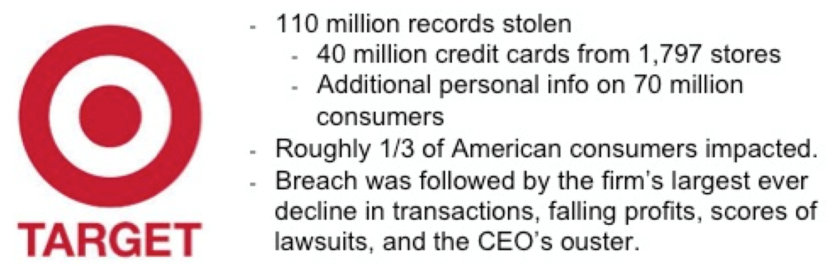
Security Breach
Factors that can amplify a firm’s vulnerability of a breach:
Personnel issues
Technology problems
Procedural factors
Operational issues
Constant vigilance regarding security needs to be:
Part of one’s individual skill set.
A key component in an organization’s culture.

Slide 25
Motivation for Information Security Attacks
Account theft and illegal funds transfer.
Some hackers steal data for personal use.
Data harvesters sell to cash-out fraudsters.
Data harvesters: Cybercriminals who infiltrate systems and collect data for illegal resale.
Cash-out fraudsters: Criminals that purchase assets from data harvesters to be used for illegal financial gain. They might buy goods using stolen credit cards or create false accounts.
Stealing personal or financial data.

Slide 26
Motivation for Information Security Attacks
Compromising computing assets for use in other crimes.
Botnets send spam, launch click fraud efforts or stage distributed denial of service (DDoS) attacks.
Botnets: Surreptitiously infiltrated computers, controlled remotely.
Distributed denial of service (DDoS) attacks: Shutting down Web sites with a crushing load of seemingly legitimate requests.

Slide 27
HACKER
Someone who breaks into computer systems
White hat hackers: Uncover computer weaknesses without exploiting them.
Contribute to improving system security.
Black hat hackers: Computer criminals who exploit a system’s weakness for personal gain.

Slide 28
Learning objectives
Recognize the potential entry points for security compromise.
Understand infiltration techniques such as social engineering, phishing, malware, Web site compromises (such as SQL injection), and more.
Identify various methods and techniques to thwart infiltration.

Slide 29
User and Administrator Threats
BAD APPLES
Rogue employees who steal secrets, install malware, or hold a firm hostage.
SOCIAL ENGINEERING
Con games that trick employees into revealing information or performing other tasks that compromise a firm.
PHISHING
Cons executed using technology, in order to:
Acquire sensitive information.
Trick someone into installing malicious software.

Slide 30
User and Administrator Threats
SPOOFED
Email transmissions and packets that have been altered to forge or disguise their origin or identity.
ZERO-DAY EXPLOITS
New attacks that haven’t been clearly identified and haven’t been incorporated into security screening systems.
PASSWORDS
Most users employ inefficient and insecure password systems
Biometrics: Measure and analyze human body characteristics for identification or authentication.
Multi-factor authentication: when identity is proven by presenting more than one item for proof of credentials.

Slide 31
Technology Threats: Malware
Seeks to compromise a computing system without permission
Methods of infection:
Viruses: Infect other software or files.
Worms: Take advantage of security vulnerability to automatically spread.
Trojans: Attempt to sneak in by masquerading as something they’re not.

Slide 32
Goals of Malware
Botnets or zombie networks: Used in click fraud, sending spam, to decipher accounts that use CAPTCHAs.
CAPTCHAs: Scrambled character images to thwart automated account setup or ticket buying attempts.
Malicious adware: Installed without full user consent or knowledge, later serve unwanted advertisements.
Spyware: Monitors user actions, network traffic, or scans for files.
Keylogger: Records user keystrokes.
Software-based or hardware-based.
Screen capture: Records pixels that appear on a user’s screen to identify proprietary information.

Slide 33
Goals of Malware
Card skimmer: Captures data from a card’s magnetic strip.
RAM scraping or storage scanning software: Malicious code that scans for sensitive data.
Ransomware: Malware that encrypts user’s files with demands that a user pay to regain control of their data and/or device.
Blended threats: Attacks combining multiple malware or hacking exploits.

Slide 34
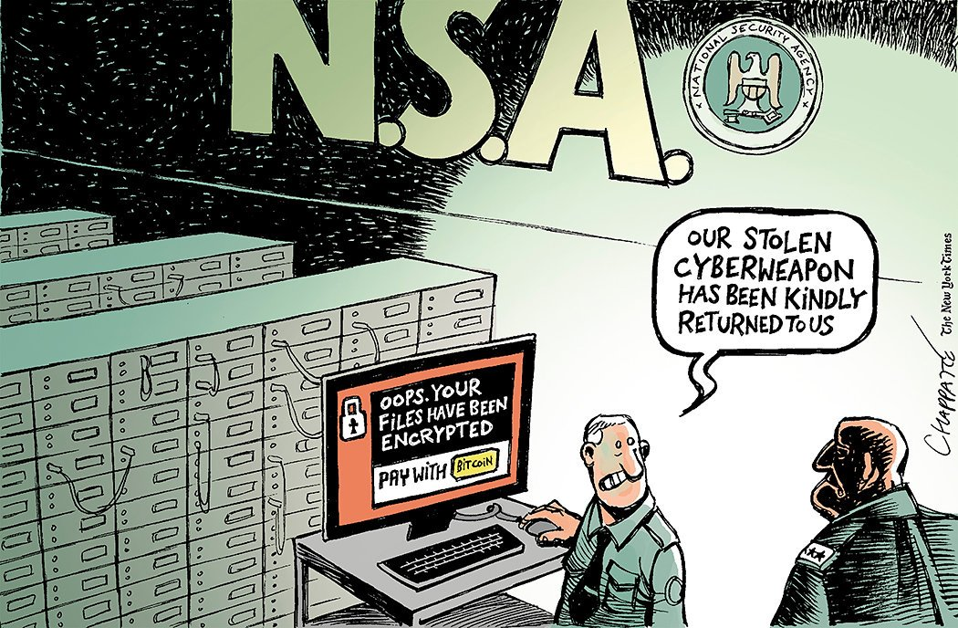
Goals of Malware
Ransomware: Malware that encrypts user’s files with demands that a user pay to regain control of their data and/or device.
https://www.nytimes.com/2017/05/17/opinion/on-the-ransomware-attack.html?_r=0

Slide 35
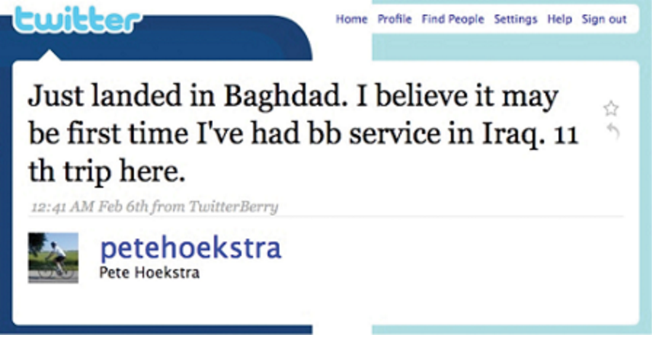
Technology Threats
Compromising poorly designed software.
SQL injection technique: Targeting sloppy programming practices that do not validate user input.
Cross-site scripting attacks and HTTP header injection.
Push-Button hacking: Tools designed to easily automate attacks.
Network threats: Network itself is a source of compromise.
A member of the House Intelligence Committee uses Twitter and reveals his locale on a secret trip.

Slide 36
Physical threats
DUMPSTER DIVING
Combing through trash to identify valuable assets.
SHOULDER SURFING
Gaining compromising information through observation.
BRUTE-FORCE ATTACKS
Exhausts all possible password combinations to break into an account.

Slide 37
Encryption
Scrambling data using a code, thereby hiding it from those who do not have the unlocking key
Key: Code that unlocks encryption.
Public key encryption: Two key system used for securing electronic transmissions.
Certificate authority: Trusted third party that provides authentication services in public key encryption schemes.

Slide 38
Learning objectives
Identify critical steps to improve your individual and organizational information security.
Be a tips, tricks, and techniques advocate, helping make your friends, family, colleagues, and organization more secure.
Recognize the major information security issues that organizations face, as well as the resources, methods, and approaches that can help make firms more secure.

Slide 39

Taking Action as a User
Tips Users Can Do:
Surf smart.
Stay vigilant.
Stay updated.
Install a full suite of security software.
Secure home networks and encrypt hard drives.
Regularly update passwords.
Be disposal smart.
Regularly back up your system.
Check with your administrator.

Slide 40
Taking Action as an Organization
Follow frameworks, standards, and compliance.
ISO27k or ISO 27000 series: Establishing, operating, maintaining, and improving an Information Security Management System.
Compliance requirements: Legal or professionally binding steps that must be taken.
Education, audit, and enforcement.
Functions of research and development:
Understanding emerging threats and updating security techniques.
Working on broader governance issues.
Employees should:
Know a firm’s policies and be regularly trained.
Understand the penalties for failing to meet their obligations.
Audits: Real-time monitoring of usage: announced and surprise.

Slide 41
How protected?
Firms should avoid:
Spending money targeting unlikely exploits.
Underinvesting in methods to thwart common infiltration techniques.
Risk assessment team: Consider vulnerabilities and countermeasure investments.
Lobbying for legislation that imposes severe penalties on crooks helps:
Raise adversary costs.
Lower one’s likelihood of becoming a victim.

Slide 42
Technology’s Role
Patches: Software updates that plug existing holes
Lock down hardware:
Prevent unapproved software installation.
Force file saving to hardened, backed-up, and monitored servers.
Reimage hard drives of end-user PCs.
Disable boot capability of removable media.
Prevent Wi-Fi use and require VPN encryption for network transmissions.

Slide 43
Technology’s Role
Lock down networks:
Firewalls: Control network traffic, block unauthorized traffic.
Intrusion detection systems: Monitor network use for hacking attempts and take preventive action.
Honeypots: Tempting, bogus targets meant to lure hackers.
Blacklists: Deny the entry of specific IP addresses and other entities.
Whitelists: Permit communication only with approved entities or in an approved manner.

Slide 44
Technology’s role
Lock down partners:
Insist on partner firms being compliant with security guidelines and audit them regularly.
Use access controls to control data access on a need-to-know basis.
Use recording, monitoring, and auditing to hunt for patterns of abuse.
Maintain multiple administrators to jointly control key systems.
Lock down systems: Audit for SQL injection and other application exploits.

Slide 45
Technology’s role
Have failure and recovery plans:
Employ recovery mechanisms to regain control if key administrators are incapacitated or uncooperative.
Broad awareness reduces organizational stigma in coming forward.
Share knowledge on hacking techniques with technology partners.

Slide 46
Protecting Information Resources - Risk
Risk. The probability that a threat will impact an information resource.
Risk management. To identify, control and minimize the impact of threats.
Risk analysis. To assess the value of each asset being protected, estimate the probability it might be compromised, and compare the probable costs of it being compromised with the cost of protecting it.
Risk mitigation is when the organization takes concrete actions against risk. It has two functions:

Slide 47
What are You doing to enhance Your Personal Cyber Security?

Slide 48
What are You doing to enhance Your Client’s Cyber Security through Your Term Project?

